Slide 1

A Solution for Closing Communication Distance for Deaf and Normal

Slide 2
Team Members
Mohd. Istiaq Hossain Junaid
Udayan Shah Upal
Faisal Hossain
Abul Kashim
Rashedur M Rahman (Supervisor)

Slide 3
Presentation Topic Overview
Purpose of Shunao
Features
Android development
Web development
Research
Future development

Slide 4
Purpose of Shunao
Learn about the deaf and hard of hearing, there are currently 1.5 billion speech and hearing impaired people in the world, and 13 million people in Bangladesh.
We are wanted to close the communication gap
Help the deaf children and their parents

Slide 5
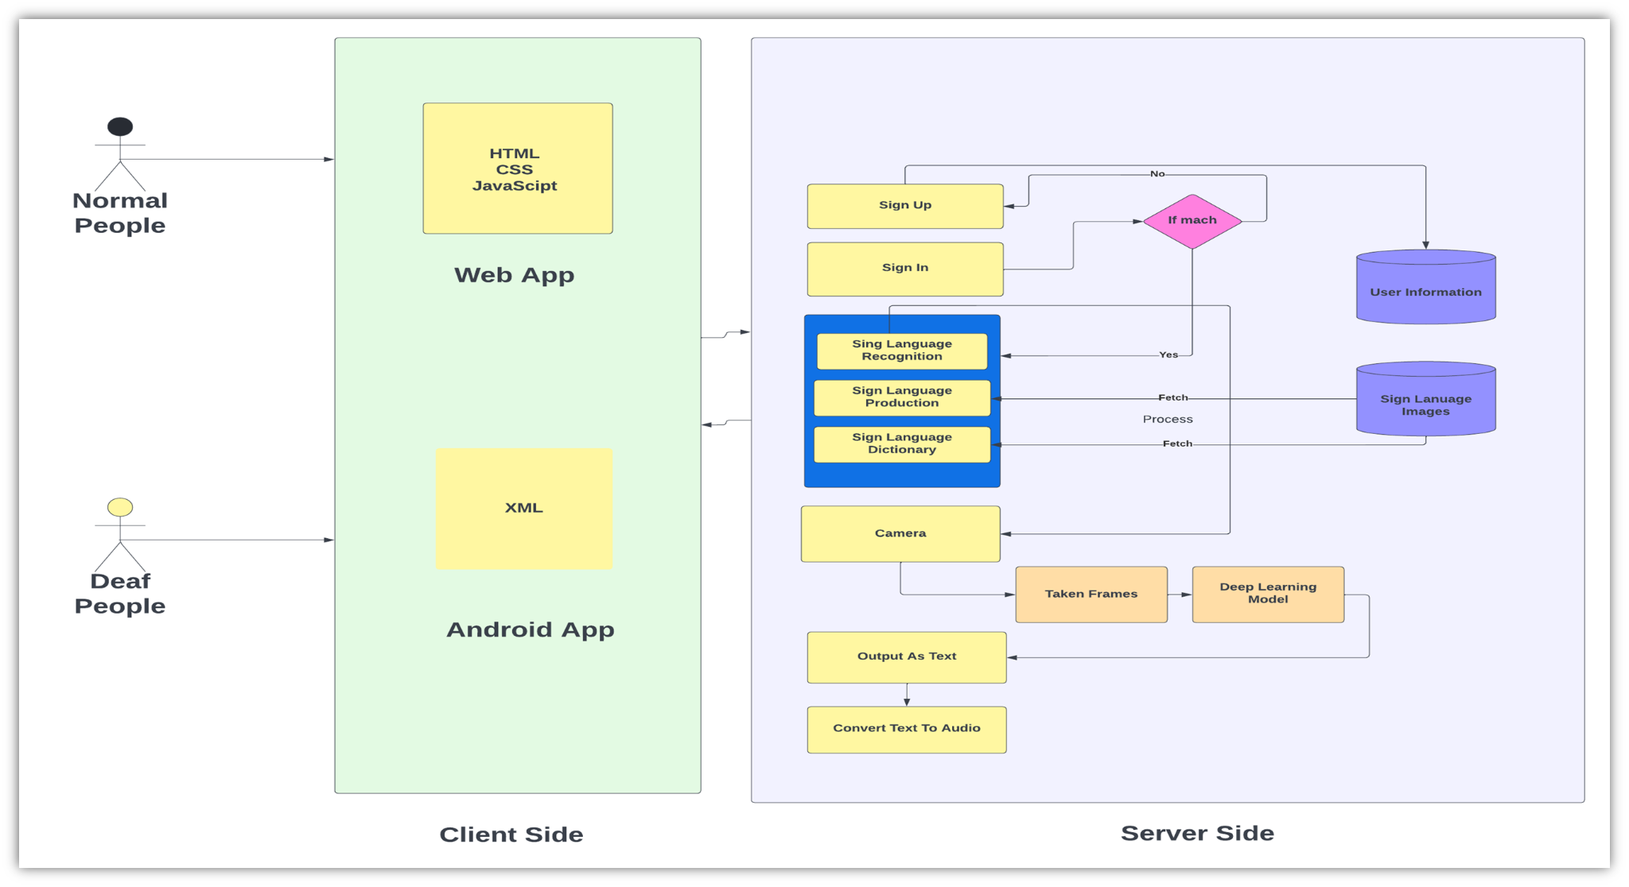
Architecture of Shunao

Slide 6
Features of Shunao
An Android Application
i) English Sign Language Recognition
ii) Bangla Sign Language Recognition
iii)Dictionary
iv)Bangla Sign Language Production
A Web Application
i) Character wise ইশারাভাষা Detection
ii)Bangla Sign Language Production
iii)Real time Bengali sign language detection

Slide 7
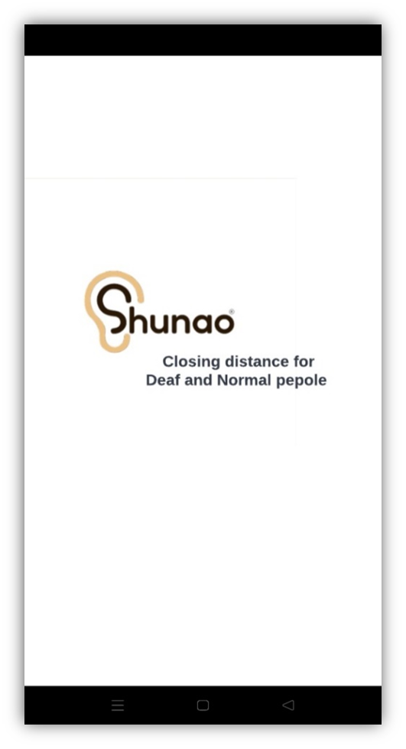
Android Development
Starting look of the App.

Slide 8
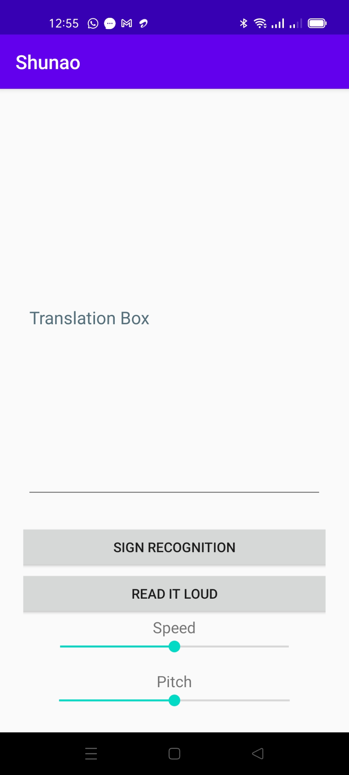
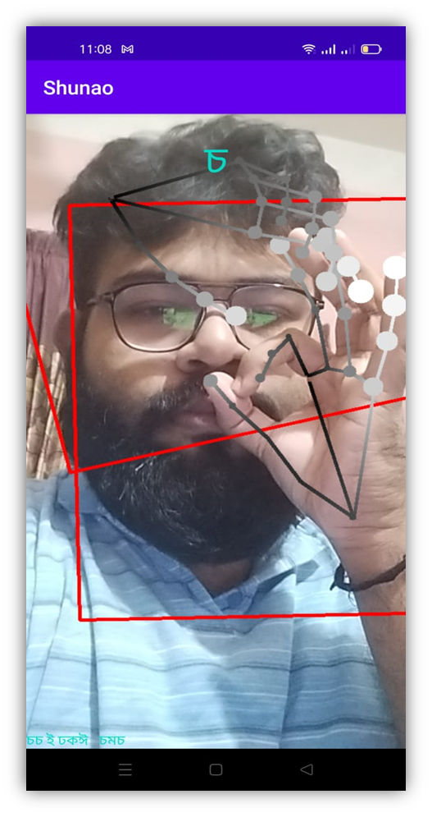
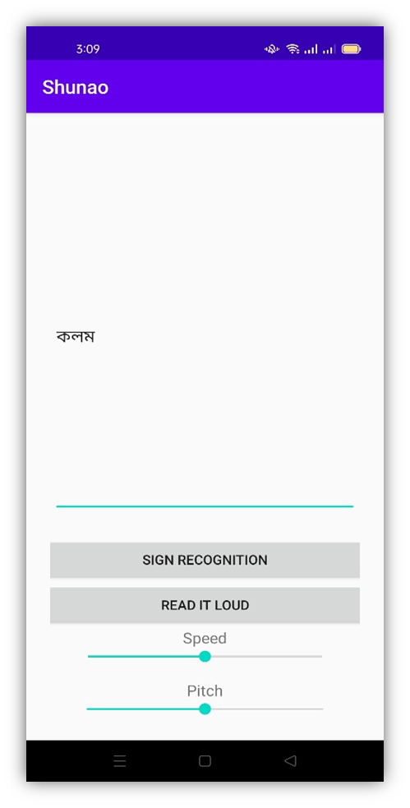
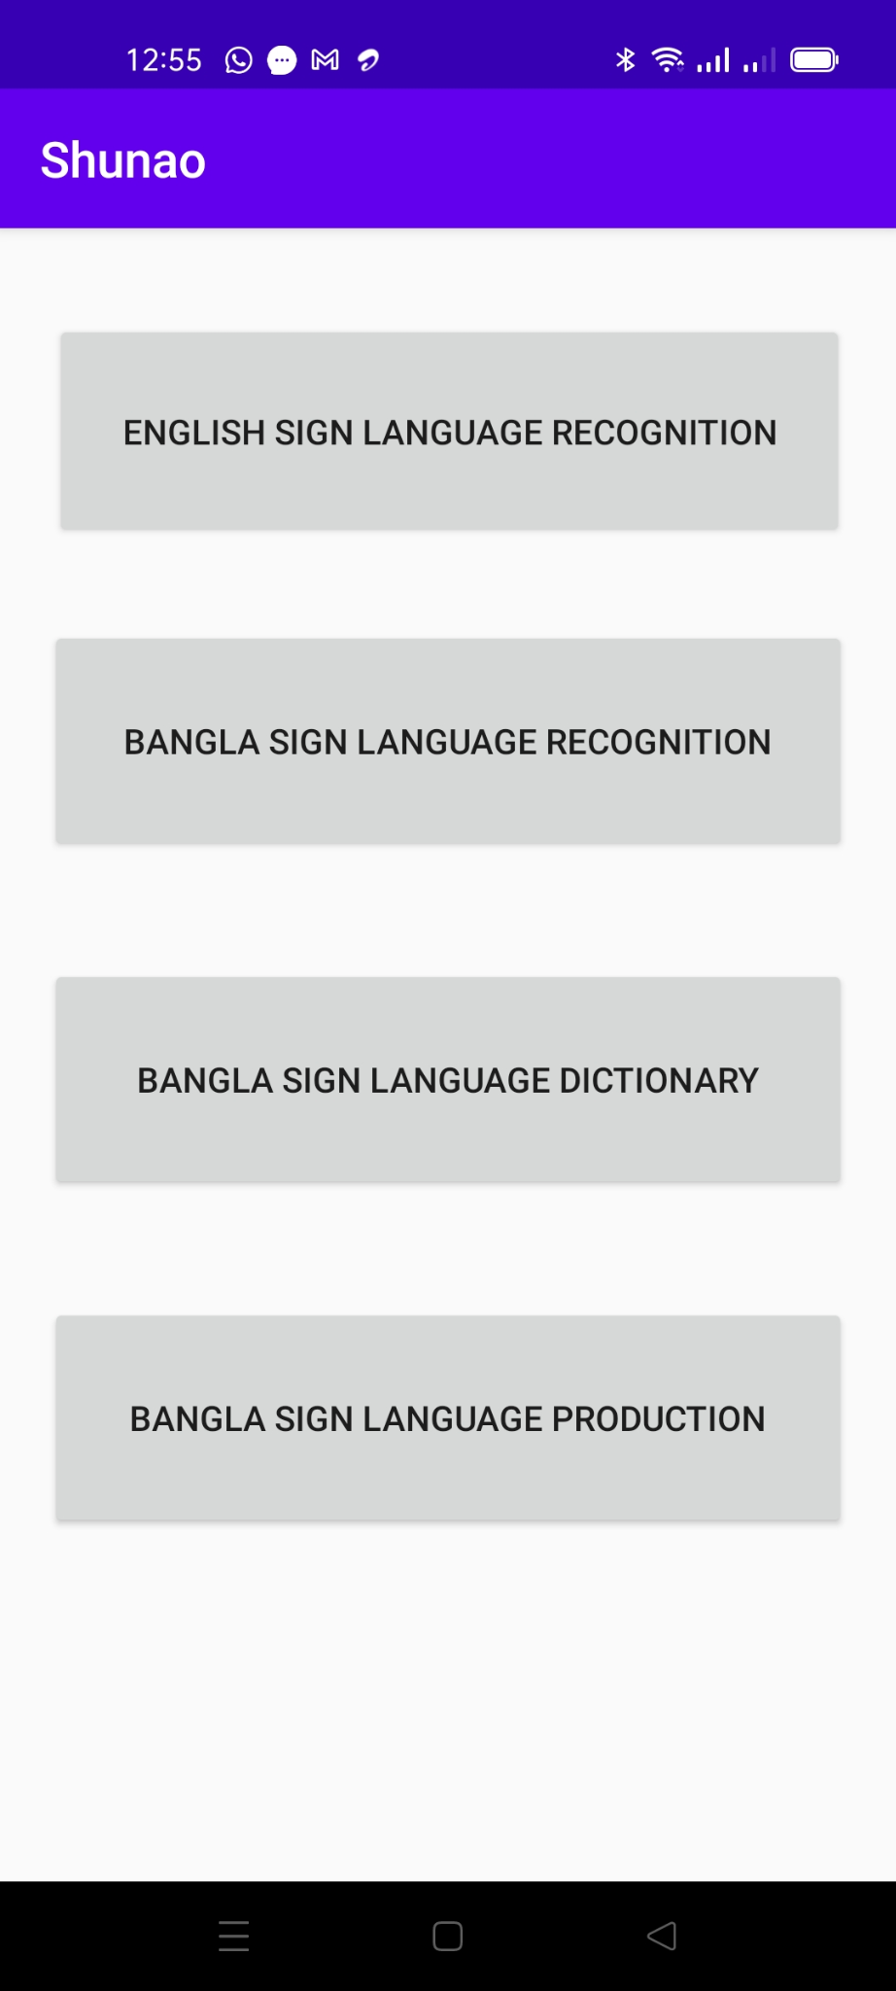
User Interface of Android Application

Slide 9
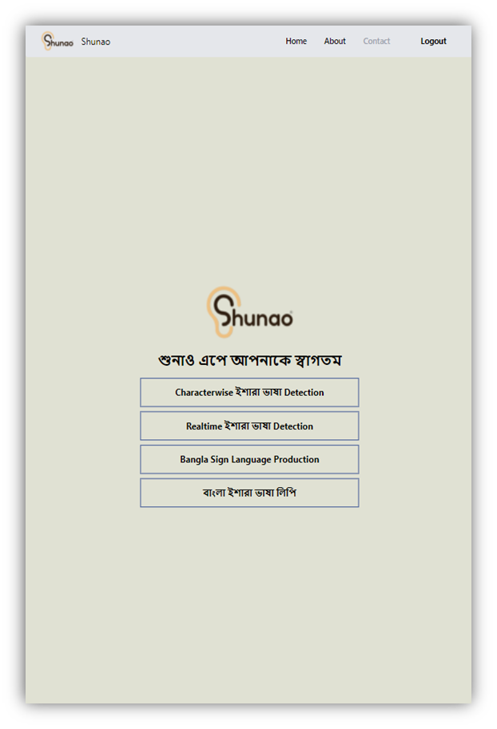
Web Development
Starting look of the App.

Slide 10
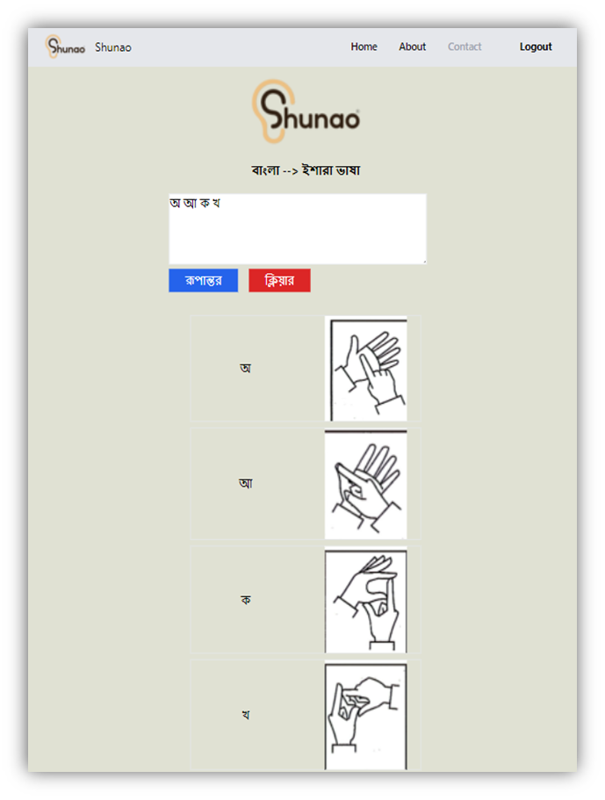
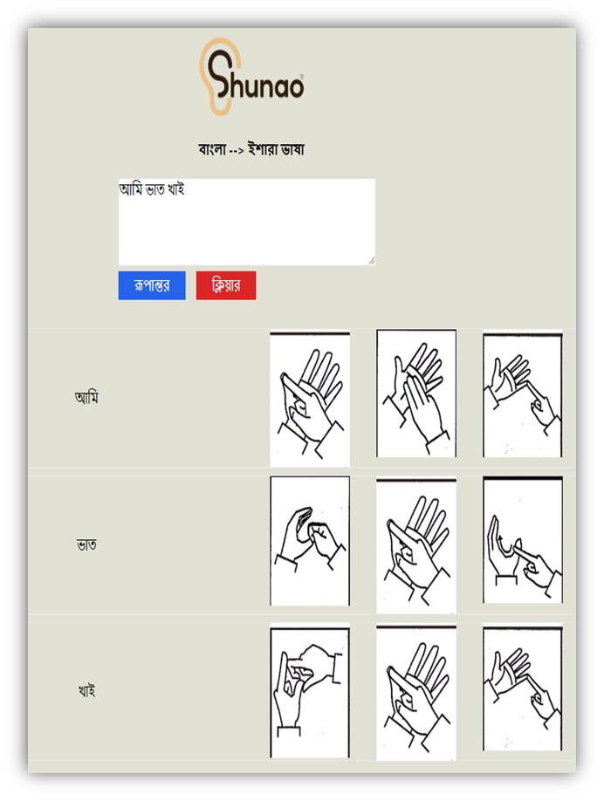
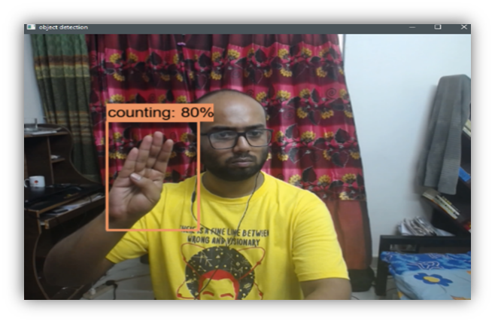
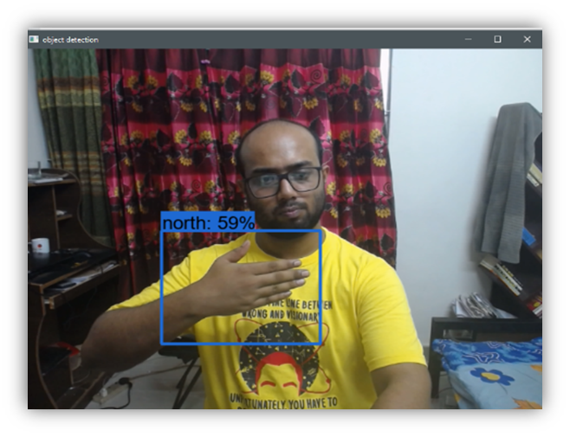
User Interface of Web Application
(b) Character wise ইশারাভাষা Detection
(c)Bangla Sign Language Production
(d) Real time Bengali sign language detection

Slide 11
Research and Gap Analysis
Researcher work on Static Images
Some of researcher use hardware solution to solve this issue
Most of them work on Alphabets numbers

Slide 12
Deep Learning based approach for Real time Bangla Sign Language Recognition Using Action Recognition
Novelity:
We have created 10 classes which reflects the general conversation
It detect the action and gives output
It does not just show alphabet . It gives output of the whole action

Slide 13
Difference between others work and us
They only focused on static images but we have focused on dynamic images
Others model is don’t give output on real time our give in real time
Other researcher focused on Alphabet we focused on Phrases

Slide 14
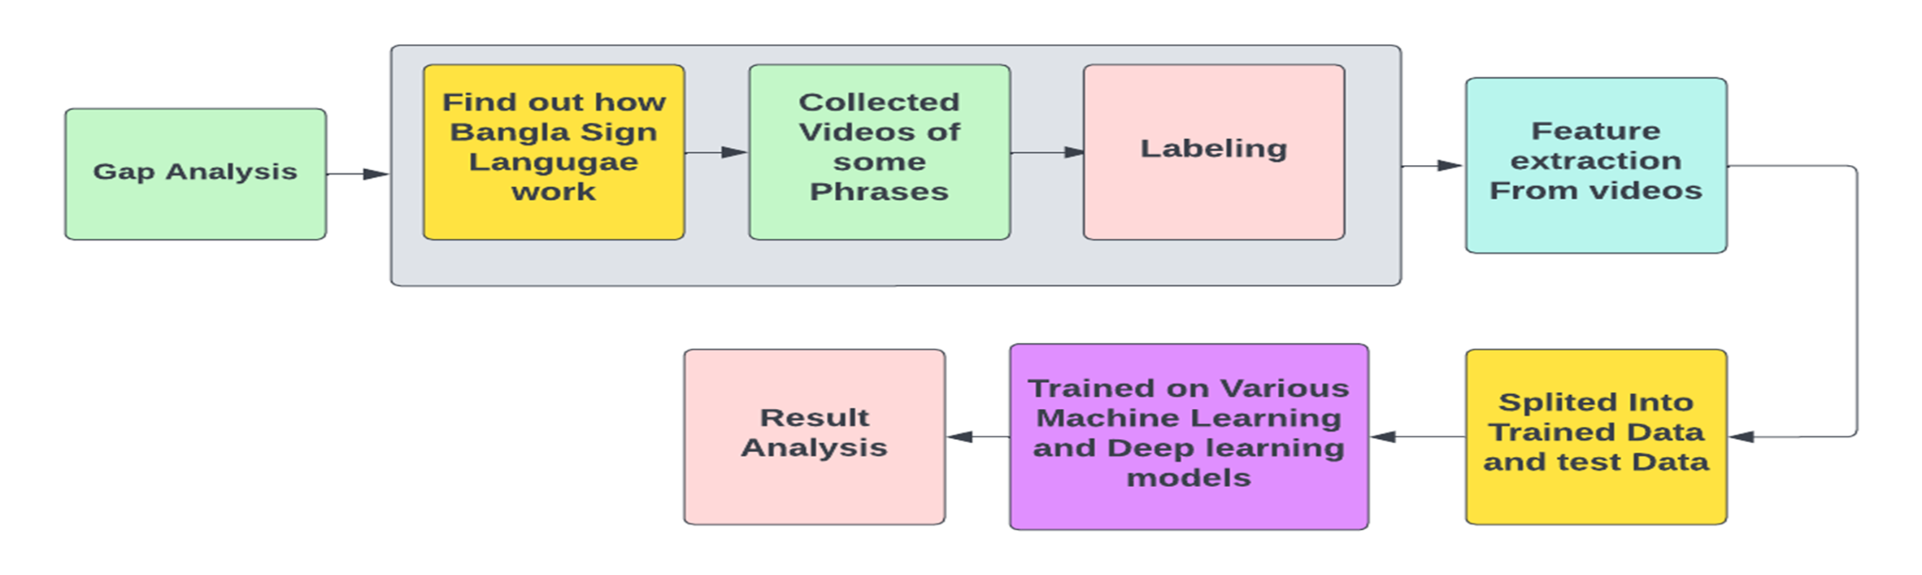
Model Building Strategy

Slide 15
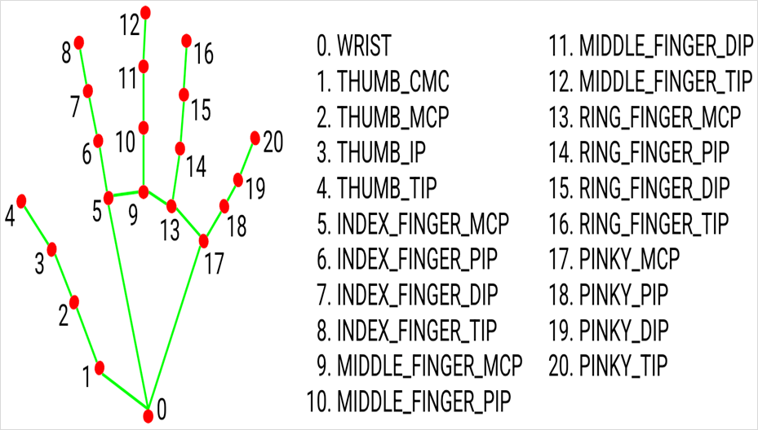
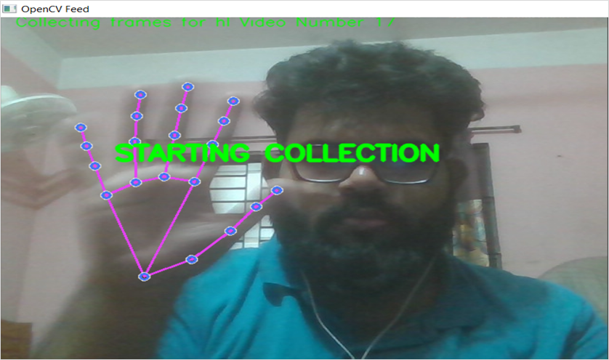
Data Collection Procedure
Figure a. Hand Tracking by Mediapipe Library
Figure 13. Key point Collection “HI “by using OpenCV and Mediapipe
We use mediapipe holistic for detect the key points.
We extracted and stored the key point as a numpy array.

Slide 16
Data Collection Procedure
We have collected 60 videos. Each videos has 60 frames.
From each frame mediapipe detects the keypoint of the hand gestures
The key point are stored in numpy arrays
Then we have split the data train and test to 80 :20 .

Slide 17
Classes of Collected Data
1.Ami Balo Achi
2.Apnake Ki Bhabe Sahajjo Korte Pari
3.Apnar Name Ki
4.Apner ki Kichu Proyonjon Ache 5.Apni Dekhte Onek Sundor
6.Apni Kemon Achen'
7.Apni ki Kaj Koren
8. Hello,
9.Koeta Baje.
10.Shubho Sokal

Slide 18
Experiment
We have used “Adam” as a optimizer ,”categorical_crossentropy” as loss function and “categorical_accuracy” as metrics
We have trained the model 232 epochs and get the best Accuracy from LSTM model

Slide 19
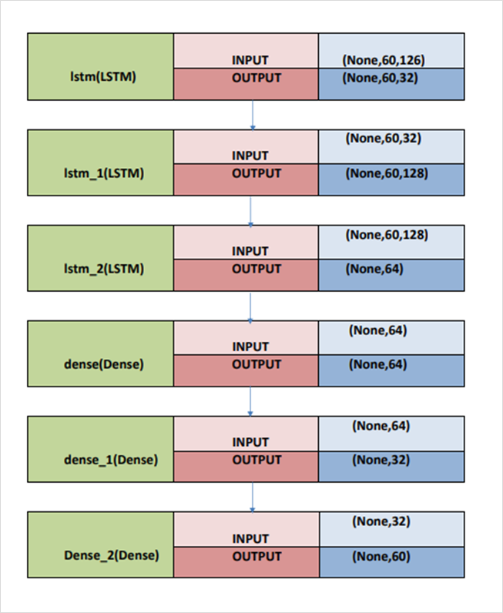
Best Model
Fig c. Fine Tuned LSTM model

Slide 20
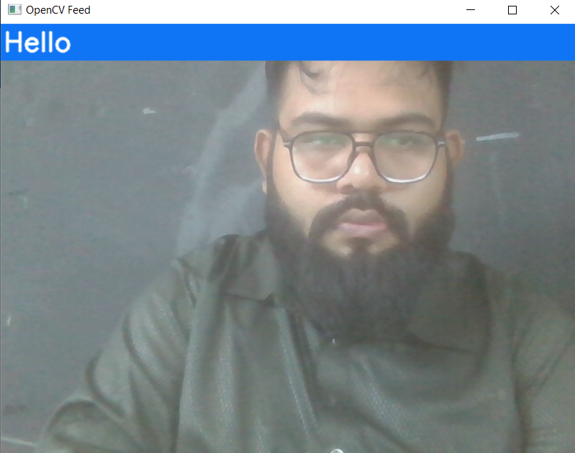
Demonstration
Fig c.Detected Hello by the model

Slide 21
Result Analysis
Result of LSTM model:
Training accuracy | Testing Accuracy | Training loss | Testing Loss
87.08% | 78.0% | 0.3718 | 0.66

Slide 22
Conclusion
We want to make complete Solution for deaf and normal people
We want to deploy the Updated model
We want to increase the Datasets for High Usage

